Slide 1



Spring Cloud: Cloud and Cloud Native Audience: All

Slide 2
Introduction
Spring Cloud: Cloud and Cloud Native
Who I am: <Instructor Name>
Title
Organization
Role
Background

Slide 3
Agenda
Spring Cloud: Cloud and Cloud Native
Microservices – History, Driving Forces, and Definition
Microservices Patterns
DevOps
Reactive Microservices
1
5
9
13
AD
All
D
AD
A
Microservices Prerequisites
Integration
Securing Microservices
Testing
2
6
10
14
AD
AD
A
D
A
A
Spring Boot
Migrating Monoliths to Microservices
Domain Driven Design Testing
Scaling Microservices
3
7
11
15
AD
D
A
A
A
Case Study
Cloud
UI
Microservices Anti-Patterns
4
8
12
16
AD
AD
All
All
A
A
Legend: All Developer Advanced Developer Architect
All
D
AD
A

Slide 4

Objectives
Spring Cloud: Cloud and Cloud Native
At the end of this training, you should be able to understand the following:
Basic of Cloud Models.
Hypervisors
Cloud Native

Slide 5
Topics
Spring Cloud: Cloud and Cloud Native
Cloud Model
Hypervisors
Cloud Native

Slide 6
Cloud: Overview
Spring Cloud: Cloud and Cloud Native
Cloud computing is the delivery of computing services – including servers, storage, databases, networking, software, analytics, and intelligence – over the Internet.
Cloud offers faster innovation, flexible resources, and economies of scale.
Clients can choose to pay only for Cloud services they use – this helps lower operating costs, run infrastructure more efficiently, and scale as per changing business needs.
Cloud
Cloud

Slide 7
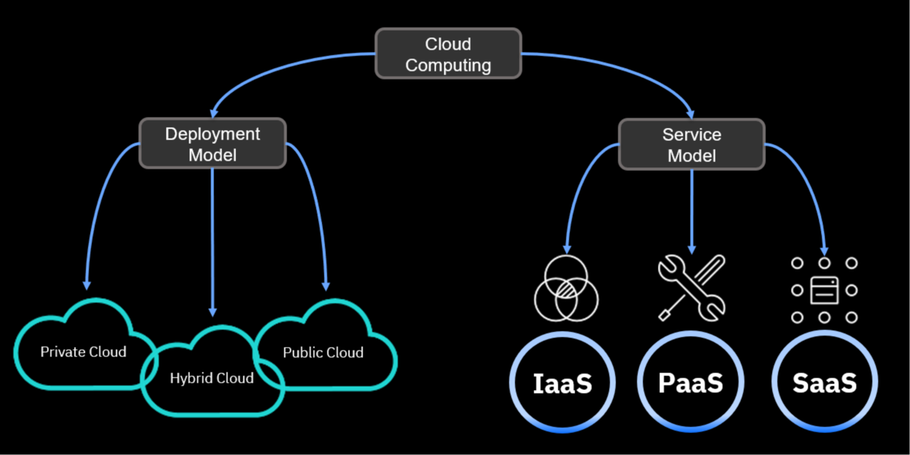
Cloud Model
Spring Cloud: Cloud and Cloud Native

Slide 8
Cloud Deployment Models
Spring Cloud: Cloud and Cloud Native
Public Clouds
Whole computing infrastructure is located on the premises of a Cloud computing company that offers the Cloud services.
Private Clouds
All computing infrastructure is hosted at the client location and is not shared. The security and control level is highest while using a private network.
Hybrid Clouds
Both private and public Clouds are used – depending on their purpose. Clients host their most important applications on their own servers to keep them more secure.
Community Clouds
It is shared between organizations with a common goal or that fit into a specific community,
Public Clouds are owned and operated by a third-party Cloud service provider. These deliver their computing resources like servers and storage over the Internet. With a public Cloud, all hardware, software, and other supporting infrastructure is owned and managed by the Cloud provider. You access these services and manage your account using a web browser.
A Private Cloud can be physically located on the company’s on-site datacenter. Some companies also pay third-party service providers to host their private Cloud. A Private Cloud is one in which the services and infrastructure are maintained on a private network.
Hybrid Clouds combine public and Private Clouds, bound together by technology that allows data and applications to be shared between them. By allowing data and applications to move between private and public Clouds, a hybrid Cloud gives businesses greater flexibility and more deployment options, and helps optimize existing infrastructure, security, and compliance.
It is shared between organizations with a common goal or that fit into a specific community. A Community Cloud in computing is a collaborative effort in which infrastructure is shared between several organizations from a specific community with common concerns, for example, security, compliance, and so on, whether managed internally or by a third-party and hosted internally or externally.

Slide 9
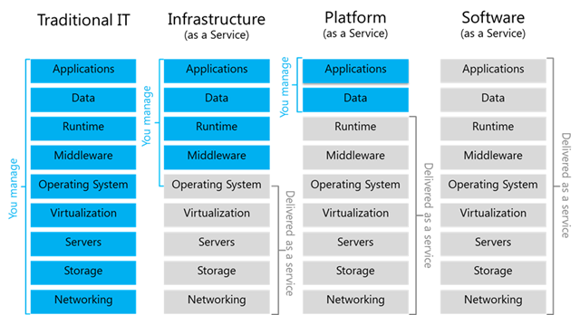
Cloud Service Models
Spring Cloud: Cloud and Cloud Native

Slide 10
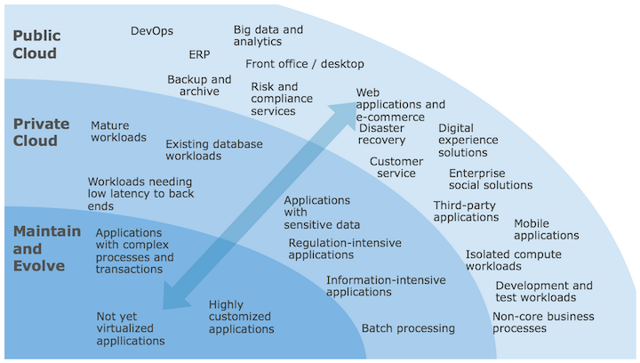
Types of Cloud
Spring Cloud: Cloud and Cloud Native

Slide 11
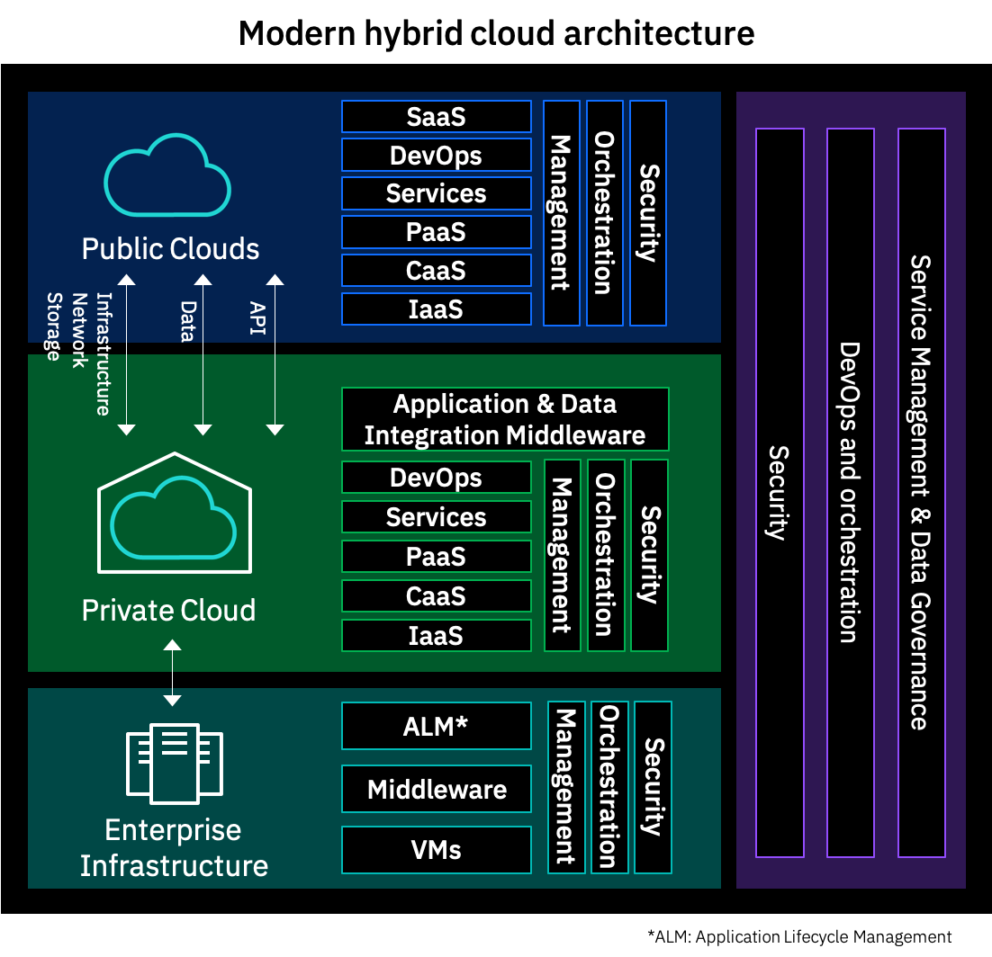
Types of Cloud (continued)
Spring Cloud: Cloud and Cloud Native

Slide 12
Types of Cloud
Spring Cloud: Cloud and Cloud Native
Cost
Cloud computing eliminates the capital expense of buying hardware and software and setting up and running on-site datacenters; the racks of servers, the round-the-clock electricity for power and cooling, the IT experts for managing the infrastructure – it all adds up fast.
Speed
Most Cloud computing services are provided as self service and on demand, so even vast amounts of computing resources can be provisioned in minutes, typically with just a few mouse clicks. This gives businesses a lot of flexibility and takes the pressure off capacity planning.
Scale
The benefits of Cloud computing services include the ability to scale elastically.
Productivity
On-site datacenters typically require a lot of “racking and stacking”— hardware setup, software patching, and other time-consuming IT management chores. Cloud computing removes the need for many of these tasks, so IT teams can spend time on achieving more important business goals.
Performance
The biggest Cloud computing services run on a worldwide network of secure datacenters, which are regularly upgraded to the latest generation of fast and efficient computing hardware. This offers several benefits over a single corporate datacenter, including reduced network latency for applications and greater economies of scale.
Reliability
Cloud computing makes data backup, disaster recovery, and business continuity easier and less expensive because data can be mirrored at multiple redundant sites on the Cloud provider’s network.
Security
Many Cloud providers offer a broad set of policies, technologies, and controls that strengthen the security posture overall, thus helping protect data, apps, and infrastructure from potential threats.

Slide 13
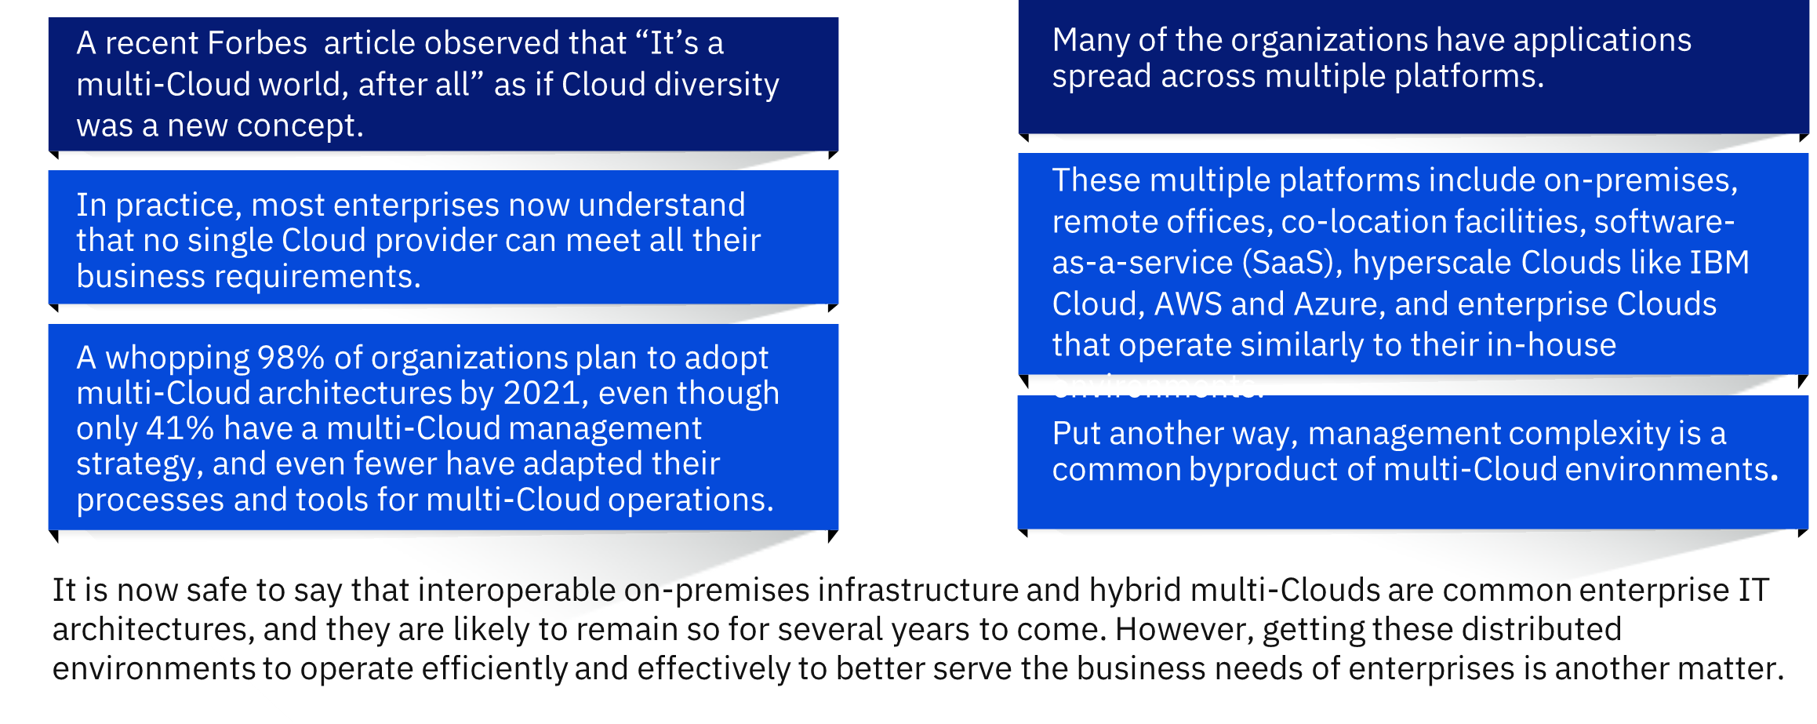
Types of Cloud
Spring Cloud: Cloud and Cloud Native

Slide 14
Hypervisors

Slide 15
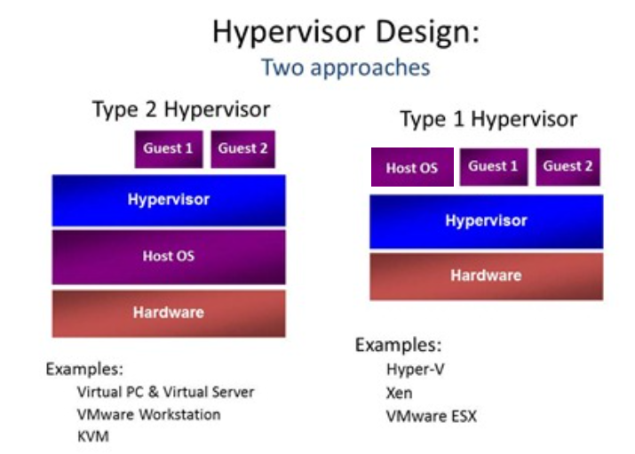
Hypervisor Types
Spring Cloud: Cloud and Cloud Native

Slide 16
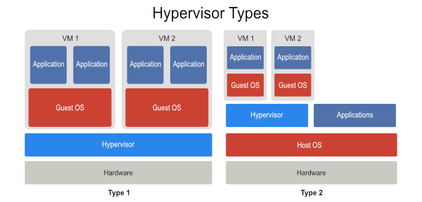
Hypervisor Types
Spring Cloud: Cloud and Cloud Native

Slide 17
Cloud Native

Slide 18




Cloud Native is not only about Cloud!
Spring Cloud: Cloud and Cloud Native
Cloud Native is an approach of designing and building modern distributed applications.
The approach is supported by 4 essential pillars.
Micro Architecture A Cloud Native application consists of discrete and reusable components known as Microservices that are designed to integrate into any Cloud environment.
Containers These Microservices act as building blocks and are often packaged in containers.
DevOps Microservices work together as a whole to comprise an application. Yet, each can be independently scaled, continuously improved, and quickly iterated through automation and orchestration processes.
Agile The flexibility of each Microservice adds to the agility and continuous improvement of Cloud Native applications.

Slide 19
Traits of a Cloud Native App
Spring Cloud: Cloud and Cloud Native
Composable
Application should be designed with small and independent “building blocks”, which can be composed to fulfill specific business functions.
Flexible
Design should promote freedom of choosing the right technology for the right tasks. Each component can be built in technology that is best suited. For example, use Python to build a mathematically complex service, while Nodejs for API(s), where large scale JSON data structure is to be manipulated.
Frictionless
Programable
Design should promote use of API(s), which can be used to construct applications. The business logic is refactored in such a way that no component crosses its domain boundaries.
The transition from development to operations should be seamless with an aim to automate the entire pipeline and toolset for managing infrastructure.

Slide 20

A few things to take care of
Spring Cloud: Cloud and Cloud Native
Although Cloud Native is an approach of choice for building modern applications, they have their own set of issues which need careful planning to mitigate.
Too many of them
Operating an environment full of micro components cooperating with each other to fulfil customer requests may become messy if right tooling is not deployed. Having log aggregators, tracing, and monitoring tools are a must for such environments.
Agile culture: End-to-end
The Cloud Native approach will not succeed if confined within development team. For a successful implementation, cultural transformation is needed across the teams from business to end user and everything in-between.
Need for speed
The approach promos frequent released in small iterations. It requires careful planning and governance. Automation of quality control is a must. Testing frequent released for regression can be daunting if testing of application is not automated.
Choose wisely
Every workload is not suitable for Cloud Native approach. While adopting Cloud Native, careful categorization and prioritization of applications is important.

Slide 21
Cloud Native in other contexts
Spring Cloud: Cloud and Cloud Native
Cloud-enabled
A Cloud-enabled application is an application that was developed for deployment in a traditional data center but was later changed so that it also could run in a Cloud environment. Cloud Native applications, however, are built to operate only on Cloud. Developers design Cloud Native applications to be scalable, platform agnostic, and comprised of Microservices.
Cloud-ready
An application is Cloud-ready if it works in a Cloud environment or a traditional app that has been reconfigured for a Cloud environment. The term ‘Cloud Native’ has a much shorter history and refers to an application developed from the outset to work only on Cloud and take advantage of the characteristics of Cloud architecture or an existing app that has been refactored and reconfigured with Cloud Native principles.
Cloud-based
A Cloud-based service or application is delivered over the internet. It is a general term applied liberally to any number of Cloud offerings. Cloud Native is a more specific term. Cloud Native describes applications designed to work in Cloud environments. The term denotes applications that rely on Microservices, Continuous Integration, and Continuous Delivery (CI/CD), and can be used through any Cloud platform.
Cloud-first
Cloud-first describes a business strategy in which organizations commit to using Cloud resources first when launching new IT services, refreshing existing services, or replacing legacy technology. Cost savings and operational efficiencies drive this strategy. Cloud Native applications pair well with a Cloud-first strategy because they use only Cloud resources and are designed to take advantage of the beneficial characteristics of Cloud architecture.

Slide 22
12 Factors
Spring Cloud: Cloud and Cloud Native
Developed by Heroku, the 12 factor method is a method to build Cloud Native software-as-a-service applications.
01. Codebase
02. Dependencies
03. Config
04. Backing services
05. Build, release, run
06. Processes
07. Port binding
08. Concurrency
09. Disposability
10. Dev/Prod parity
11. Logs
12. Admin Processes
One codebase tracked in revision control, many deploys
Explicitly declare and isolate dependencies
Store config in the environment
Treat backing services as attached resources
Strictly separate build and run stages
Execute the app as one or more stateless processes
Export services via port binding
Scale out via the process model
Maximize robustness with fast startup and graceful shutdown
Keep development, staging, and production as similar as possible
Treat logs as event streams
Run admin/management tasks as one-off processes

Slide 23

Q&A

Slide 24

Summary
Spring Cloud: Cloud and Cloud Native
Summary
In this course, you learned about the following:
Cloud Models,
Hypervisors
Cloud Native

